Slide 1
22nd
Task Force on Measurement and Modelling
Online Meeting, 10-12 May 2021
Modeling Activities in Turkey
Canan Esin KÖKSAL, Environmental Expert, MSc.
Republic of Turkey; Ministry of Environment and Urbanization
DG for Environmental Management

Slide 2
On behalf of and with thanks to the wider team
Content
Air Quality Management in Turkey
1
Modeling
2
Future tasks&plans
3
22nd Task Force on Measurement and Modelling Meeting, 10-12 May 2021

Slide 3
Our Team
Air Quality Assessment Division
Act. Division Manager
Env. Expert
Env. Expert
Staff
Mrs İrde GÜRTEPE
Ms Ağça GÜL
YILMAZ
Mrs. Canan Esin KÖKSAL
3 Project Assistants
Our Colleague; Mrs. Evrim ÖZTÜRK
22nd Task Force on Measurement and Modelling Meeting, 10-12 May 2021
EEA, Denmark

Slide 4
Content/1
Air Quality Management and components in Turkey
22nd Task Force on Measurement and Modelling Meeting, 10-12 May 2021

Slide 5
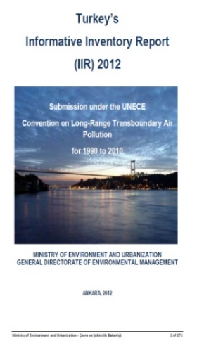
Timeline for Air Quality Management
in Turkey
Projects under IPA-I Period
National Air Management Strategy
Clean Air Centers’ start
Background for UN ECE LRTAP Reporting
HEY Portal
All-in-one Air Emission Management Portal starting point
2008
2012
2018-…
2011
2014
Accelerating Point
1st LRTAP Reporting
Digital Air Management
EU Accession Period
Environment Chapter
New By-law-BAQAM
Background for Clean Air Action plans (CAAPs)
for provinces
Software developments are getting extended.
New international projects
22nd Task Force on Measurement and Modelling Meeting, 10-12 May 2021

Slide 6
Content/2
Modeling
22nd Task Force on Measurement and Modelling Meeting, 10-12 May 2021

Slide 7
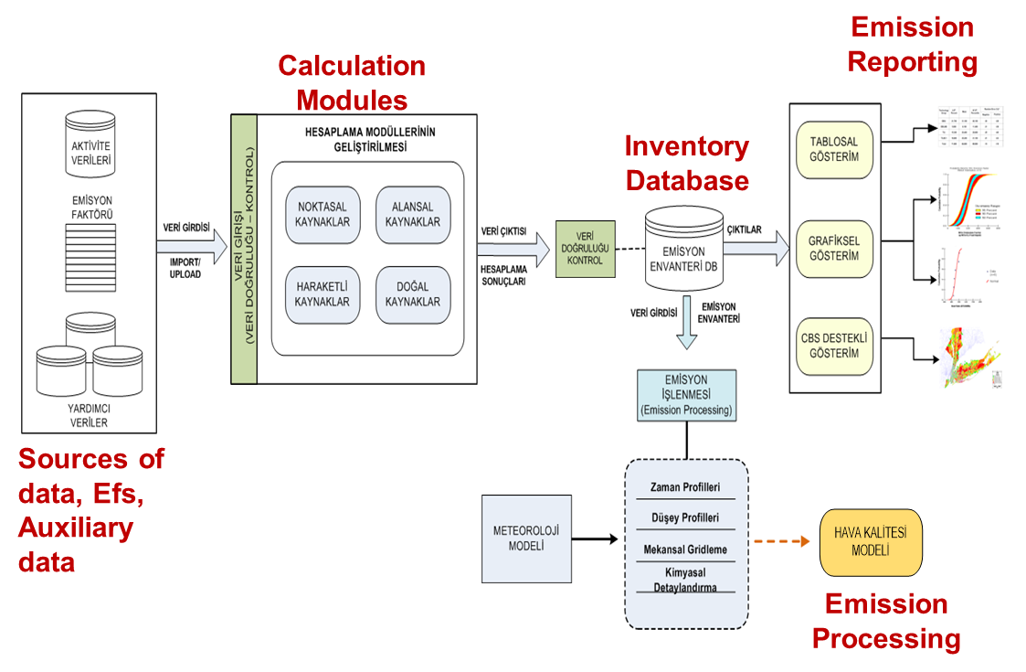
Point, line, area sources and natural sources
Global AQ Model
Meteorological Model
Time profiles, gridding, chemical speciation

Slide 8
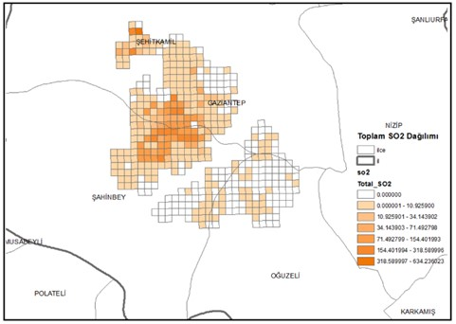
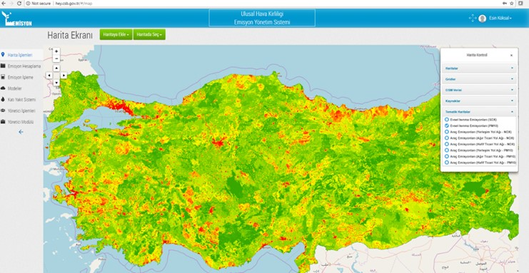
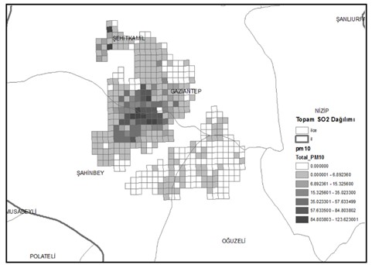
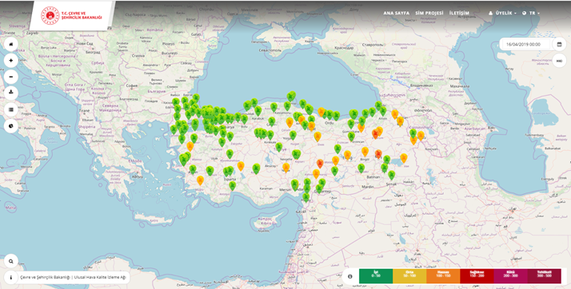
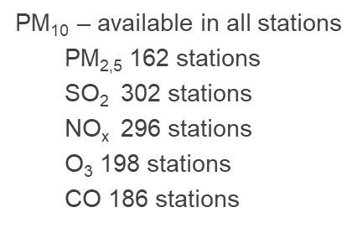
Improvements
Air Emission Management Portal
5087 facilities’ data;15000 stacks
Emission distribution
Meteorological and air quality models are available all-in-one.
Longrange transport is included.
Pollutants – wide extent
8 Clean Air Centers, 355 fixed monitoring stations; all of them measuring SO₂ and PM₁₀ ; half of them PM_{2,5}
CITYAIR Project with INERIS and CITEPA
National funded projects for the Air Emission Management Portal and forecast and 3D air maps
Low Emission Zone studies on the way
Specific Measures for provinces; case/pilot studies
Scenario results for comparison
Projections; on the way
Maps / Gridding

Slide 9
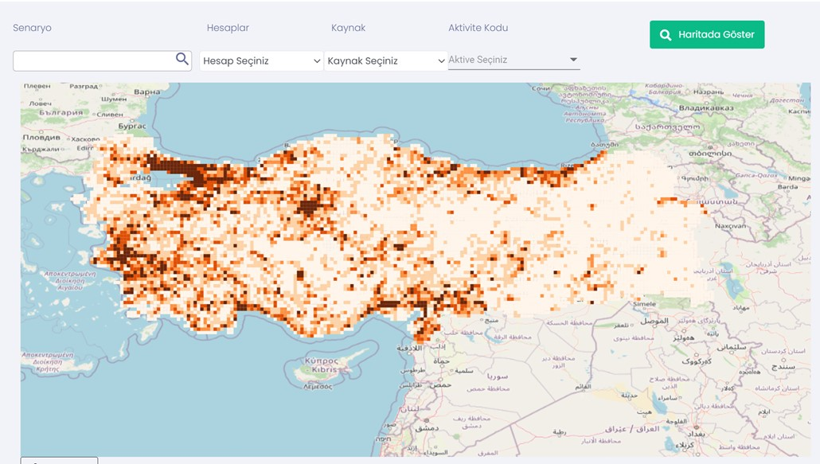
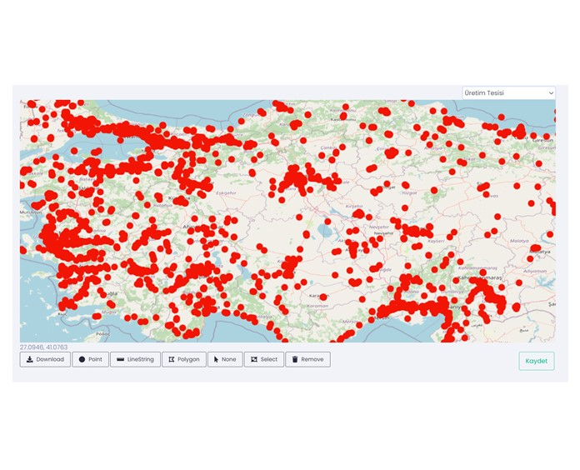
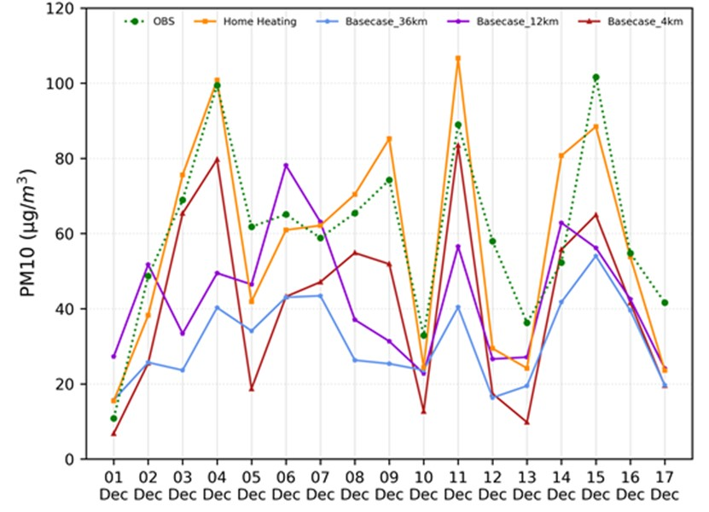
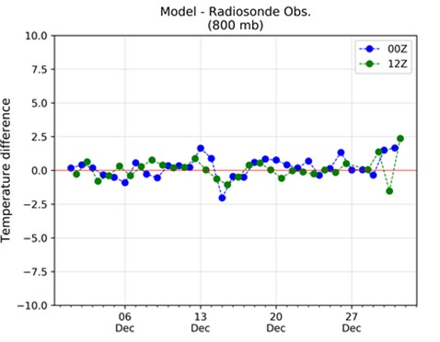
Special data requirements are covered.
For solid fuels, seperate moduled is developed and will be integrated with daily submission of usage in national scale.
Forecast is being studied to be integrated with the Portal together wtih the city-profile with 3D.
AIR EMISSION MANAGEMENT PORTAL
Location based data integration, add-drop is available.
GIS based data configuration is available.
Regional and local maps are available for emission distribution.
All sources regarding the main activities are included.
Industry
Residential Heating
Transport
Agriculture
Continuous Development
New Tools
Flexible study
Country profile
IT linkage
Data coverage
22nd Task Force on Measurement and Modelling Meeting, 10-12 May 2021

Slide 10
Strategical air quality maps are prepared using the «all-in-one»unique system-Air Emission Management (AEM) Portal of the Ministry of Environment and Urbanization including:
GIS based city information,
sectoral data,
fuel usage from provinces and
air quality modeling
Air quality visualization studies including forecast will be developed for Turkey by integrating AEM Portal with the
3D city information systems,
road network,
city topographical information and traffic density data.
From national scale to city-level scale, all required further studies are ongoing with the components of air emission inventory, modeling, measurement and scientific background.

Slide 11
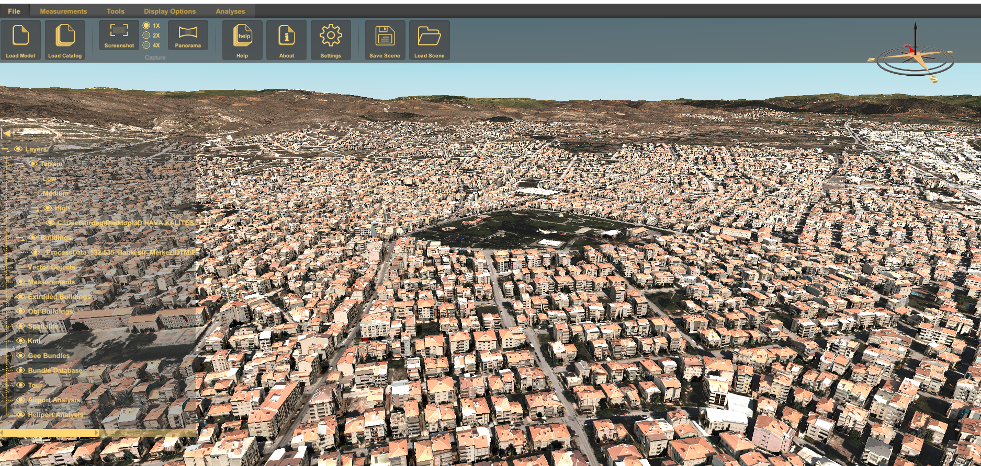
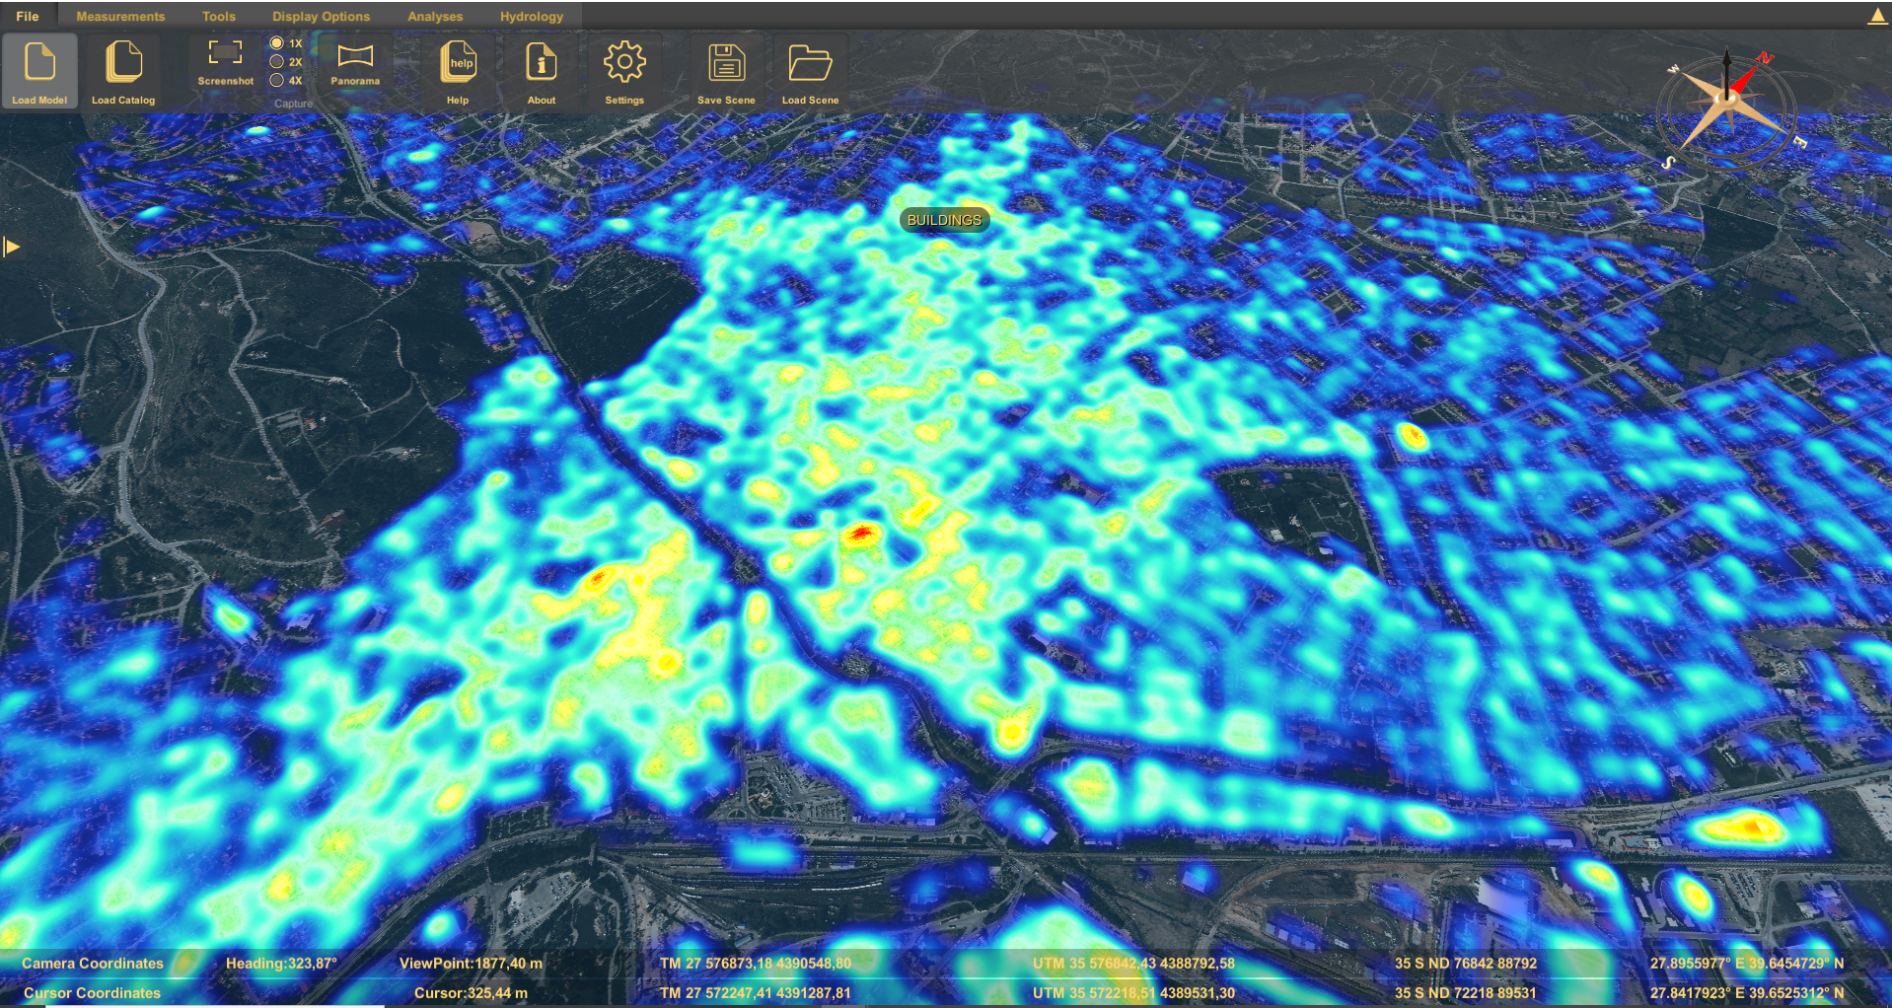
<AIRFACE>
5 cities >> 20 cities
City-information systems to be integrated
City geographical properties
Support for decision-making

Slide 12
Content/3
Future Tasks&Plans
22nd Task Force on Measurement and Modelling Meeting, 10-12 May 2021

Slide 13
Future Tasks
Air Management Portal
Maps to be completed national and with historical data
Results to be reflected in scientific articles
Solid fuel data module
Official submission integration with the national users
SUBMIT
Forecast module
At first case studies, then official outputs
CAAPs revision
Model results to be concluded

Slide 14
Future Tasks
From Regional to National Scale and
From Local to Regional Scale
Increasing the data coverage and availability
Decreasing the uncertainties within the inventory
Extending the provinces with city specific GIS and 3D outputs
Achieving model results nationawide
Publishing the results via scientific articles and at the scientific activities
Searching the opportunities for experience and information exchanges under international platforms

Slide 15
Thank You for your Attention
cesin.koksal@csb.gov.tr
22nd Task Force on Measurement and Modelling Meeting, 10-12 May 2021

